Slide 1

Installing Python and Visual Studio Code on MacOS

Slide 2
Before installation
Make a folder for your future Jupyter notebook files – for instance in the same folder as your lecture notes etc.

Slide 3
Check If you have an existing Python installation
Verify Python Installation
Open the Terminal app (you can find it using Spotlight with Cmd + Space and typing "Terminal").
Type :
python3 --version
and press Enter. This should display the version of Python if it's installed correctly.

Slide 4

Install Python on Mac
Download Python
Go to the official Python website at https://www.python.org/downloads/
Click on the download link for the latest Python version for macOS.
Install Python
Open the downloaded .pkg file to start the installation.
Follow the installation instructions.
Verify Python Installation
Open the Terminal app (you can find it using Spotlight with Cmd + Space and typing "Terminal").
Type: python3 --version and press Enter. This should display the version of Python if it's installed correctly.
If prompted, tick the box saying “Add python.exe to PATH

Slide 5
Install Homebrew
Installing Homebrew on Mac
Open the Terminal
You can find the Terminal app using Spotlight (Cmd + Space) and typing "Terminal".
Install Homebrew
In the Terminal, paste the following command (this is the official installation script from Homebrew):
/bin/bash -c "$(curl –fsSL https://raw.githubusercontent.com/Homebrew/install/HEAD/install.sh)"
Press Enter to execute the command.
Follow the on-screen instructions to complete the installation.
Verify Homebrew Installation
After installation, type “brew doctor” in the Terminal and press Enter.
This command checks for any issues with the Homebrew installation. It should say “Your system is ready to brew” if everything is fine.
Add Homebrew to PATH (if necessary)
The installation script typically takes care of this, but if you can’t run brew commands, you may need to add Homebrew to your PATH.
You can do this by adding the following line to your .zshrc file (for zsh, the default shell in macOS):
echo 'eval "$(/opt/homebrew/bin/brew shellenv)"' >> /Users/$(whoami)/.zshrc eval "$(/opt/homebrew/bin/brew shellenv)"

Slide 6

Updating Homebrew and Installing Python
Installing Python via Homebrew and Updating Homebrew
Before installing Python, it's a good practice to update Homebrew. In the Terminal, type:
brew update
Install Python
Now, to install Python, use the command:
brew install python
This will download and install the latest version of Python.
Verify Python Installation
Once the installation is complete, you can verify it by typing:
python3 --version
This should display the installed version of Python.

Slide 7
Downloading and Installing Visual Studio Code
Installing Visual Studio Code (VS Code) on Mac
Download VS Code for Mac
Visit the official Visual Studio Code website at https://code.visualstudio.com/ or use ITU-Services
Click on the “Download for Mac” button. It will download a .zip file.
Install VS Code
Open the downloaded .zip file. This will extract the application.
Drag the Visual Studio Code app to the Applications folder, so it's available in the Launchpad.
Launch VS Code
Open the Launchpad and click on the Visual Studio Code app.
(Optional) Install Command Line Tools
Open VS Code.
Press Cmd + Shift + P to open the Command Palette.
Type Shell Command: Install 'code' command in PATH and select it.
This allows you to launch VS Code from the terminal by typing code.

Slide 8
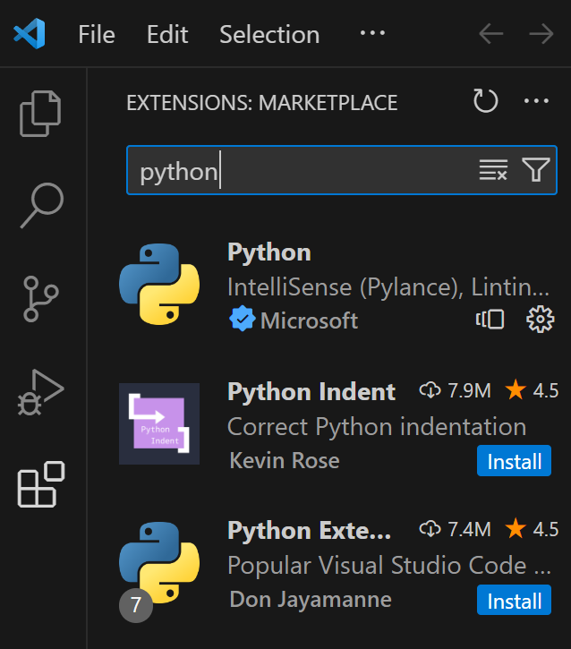
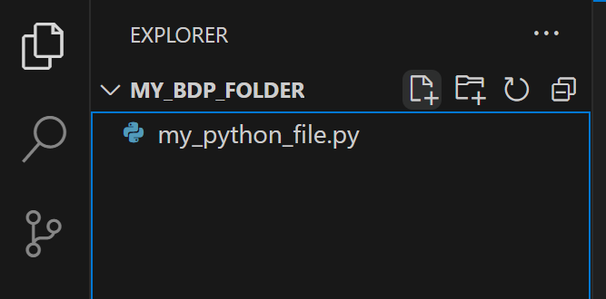
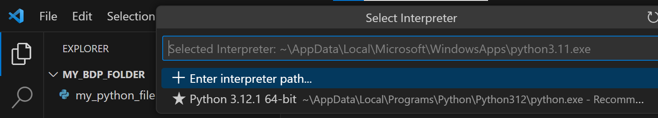
Configure Python in VS Code
Setting up Python in VS Code
Open VS Code
Launch Visual Studio Code.
Install the Python Extension
Click on the Extensions view icon on the Sidebar or press Cmd + Shift + X.
Search for Python and select the one published by Microsoft.
Click Install.
Select Python Interpreter
Once the extension is installed, navigate to the “files”-tab
Click on the “Open Folder” button and choose the folder you made in the beginning
Make a new python file in the folder by clicking the file+-icon
Name the file anything you like, but remember to end it with .py
A prompt may appear asking you to select a Python interpreter. If not, open the Command Palette (Ctrl + Shift + P) and type Python: Select Interpreter.
Choose the Python version you installed earlier
Test Python Setup
In your new file you can now test your python setup
Type a simple Python command, like print("Hello, world!").
Right-click in the file and select Run Python File in Terminal to execute the script. The terminal in the bottom should now print “Hello World!”

Slide 9
Additional Resources and Links
VS Code Documentation: https://code.visualstudio.com/docs
Python Documentation: https://docs.python.org/3/

Slide 10
Additional notes on Homebrew
Additional Notes
Python via Homebrew vs System Python: macOS comes with a system version of Python. However, it's recommended to use the version installed via Homebrew as it is more up-to-date and does not interfere with the system Python.
Using Pip: Homebrew's Python installation includes pip, Python's package manager. You can use it to install Python packages.
Additional Resources
Homebrew Documentation: https://docs.brew.sh/

